Slide 1
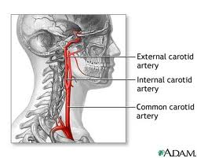
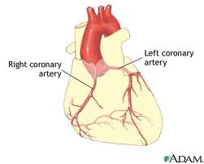
LDL goal < 70 mg/dL
CHD (Coronary Heart Disease): artery supplying O2 to the heart (figure on the left)
Angina: plaque in coronary artery → ischemia
MI (heart attack): plaque in coronary artery → tissue necrosis
  Coronary Bypass graft: move tissue from one site to another on the body, or from another person, without bringing its own blood supply with it.
  Coronary Angioplasty (temporary widening)
  Coronary Stent Placement
CaroTID artery disease: artery supplying blood to the brain (figure below)
Stroke
TIA (transient ischemic attack): blood flow to a part of the brain stops for a brief period of time. A person will have stroke-like symptoms for up to 1-2 hours
caroTID stenosis (>50%) abnormal narrowing of the Carotid artery
Notes:
If the patient has problems with their arteries supplying blood to:
Heart (coronary artery)
Brain (CaroTID artery)
Then LDL goal < 70

Slide 2
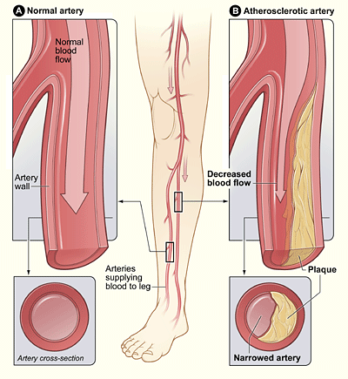
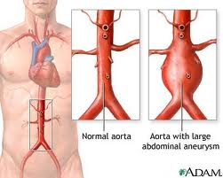
LDL goal < 100 mg/dL (CHD Risk Equivalents)
Diabetes Mellitus
10 year risk for CHD>20% (from Framingham score)
Other forms of atherosclerotic disease
  Peripheral arterial disease: Plaque in periphery (figure on the left)
  Abdominal aortic aneurysm: ballooning of a portion of an artery
  (figure on the right)
Notes:
If patient has problems with arteries supplying to the ‘other’ arteries (not heart nor brain):
Peripheral arteries
Aorta
Then LDL goal <100. Also:
DM
CHD risk >20%

Slide 3
5 Major risk factors (if 2 or more risk factors, calculate Framingham score)
1. Age (Men >45yrs; women >55yrs)
2. Cigarette Smoking
3. Hypertension
  BP >140/90mmHg or on antihypertensive medication
4. Low HDL cholesterol* (<40mg/dL) HDL > 60 = negative risk factor
5. Family hx of premature CHD
  CHD in male first degree relative <55yrs
  CHD in female first degree relative <65yrs
1. Age because old people get everything
2. Cig smoking because smokers get everything
3. HTN because lipids cause HTN. So HTN cause lipids?
4. Low HDL because that’s the good cholesterol
5. Family because of genetics

Slide 4
When to use drug treatment?
Risk Category | LDL level at which to initiate TLC For 3 months | LDL level at which to consider drug tx | LDL Goal (mg/dL)
Slide 1 CHD (aka CAD) | If LDL > 100 Start TLC & tx | If LDL > 100 Start TLC & tx | goal:<70mg/dL
Slide 2 Abdominal aortic aneurysm Peripheral arterial disease 10 year risk for CHD>20% Diabetes Mellitus | If LDL > 100 Start TLC & tx | If LDL > 100 Start Therapeutic lifestyle change | <100 goal:<70mg/dL
Slide 3 2+ Risk Factors (10-yr risk 10-20%) | If LDL > 130 Start Therapeutic lifestyle change | If LDL is > 130 mg/dL After 3 months of TLC | goal:<130mg/dL)
Slide 3 2+ Risk Factors (10-yr risk <10%) | >130 | >160 After 3 months of TLC | <130
Slide 3 0-1 Risk Factors (10-yr risk <10%) | >160 | >190 After 3 months of TLC | <160

Slide 5
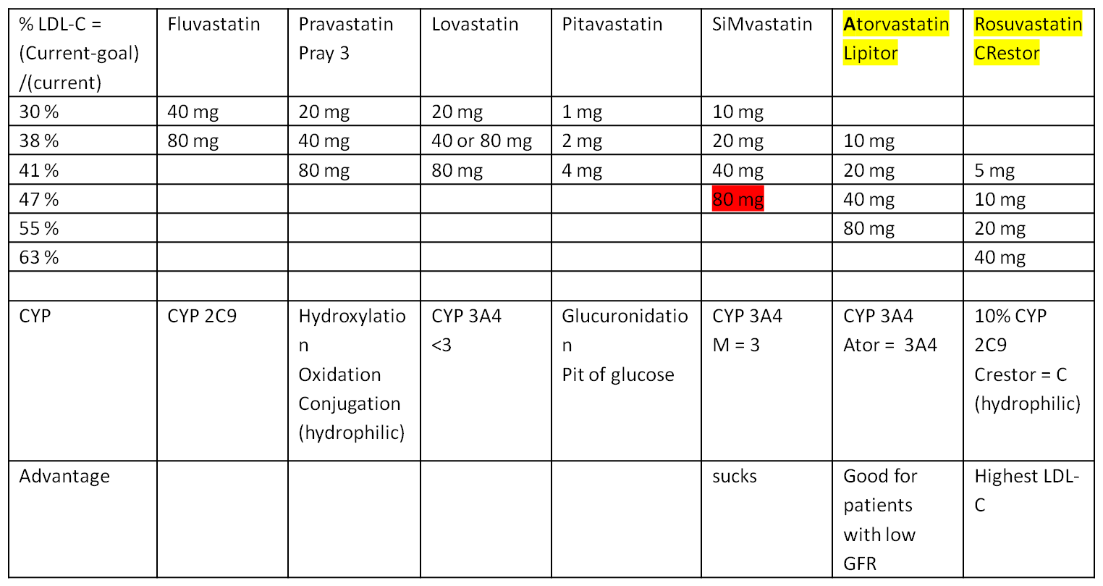
Monitoring Parameters
  Muscle pain (possibly rhabdo)
  Lipid profile _6 weeks_ after dose change, then Q 6 mo long term.
  LFTs (liver function test) at baseline, _3 months_, and periodically thereafter.
  CPK (Creatine Phosphokinase) at baseline and if the patient has symptoms of myalgia.
    If > 10 ULN (upper limit or normal) or 10,000 IU/L → discontinue statin
  Pregnancy Category X
Notes:
Percent decrease = (current – goal)/current
LDL in 6 weeks
LFT in 3 months
CK at baseline

Slide 6
Ezetimibe (Zeita)
10 mg daily
When to use?
Combination therapy in patients with Chronic Kidney Disease
Fibric Acid Derivatives
Gemfibrozil 600 mg BID
Fenofibrate Use Fenofibrate if there is muscle pain with statin
When to use?
TC > 200
HDL < 40
Patient is on a statin with controlled LDL
Why use? To lower TG
Fish Oil
Lovaza 1g/day as anti-inflammatory
2-4 grams/day for TG effect
Nicotinic Acid (Niacin) → accodring to AIM-HIGH study, there is no benefit in Niacin + statin combo
Niacin ER 500 mg PO qhs (hepatotoxic)
Niacin 100 mg PO BID w/ food (flushing)
Monitoring Parameters Nicotinic Acid
Uric acid and glucose at baseline and again after stable dose reached (or symptoms produced), more frequently in diabetic patients.
Lipid profile after 1,000–1,500 mg/day and then after stable dosage achieved; then Q 6–12 mo long term.
LFTs at baseline and Q 6–8 wk during dose titration; then as needed for symptoms.
Bile Acid Resins
Monitoring Parameters
Lipid profile Q 4–8 wk until stable dose; then Q 6–12 mo long term.

